Slide 1





Interactive Simulation of Composition of Forces
Object-Oriented Programming/2023.2
Group 18

Slide 2
Group Member
Ngô Minh Trung
Develop: GUI, class PhysicalObject, class Cylinder, class Force, class Cube, class Surface
20226004
Design: Slide + Report Preparation, Use case Diagram
Phan Hoàng Tú
Develop: testing application on terminal
20226068
Design: general class diagram
Đặng Trọng Văn
Design: Class Diagram
20226072

Slide 3
1
Project description

Slide 4
Project Description
In the simulation , the user controls a physical system.
Physical system includes 3 components:
A main object (either a cube or a cylinder)
A horizontal surface
An actor who can apply a horizontal force
The user can control all the components of the physical system and observe the motion of the main object.

Slide 5
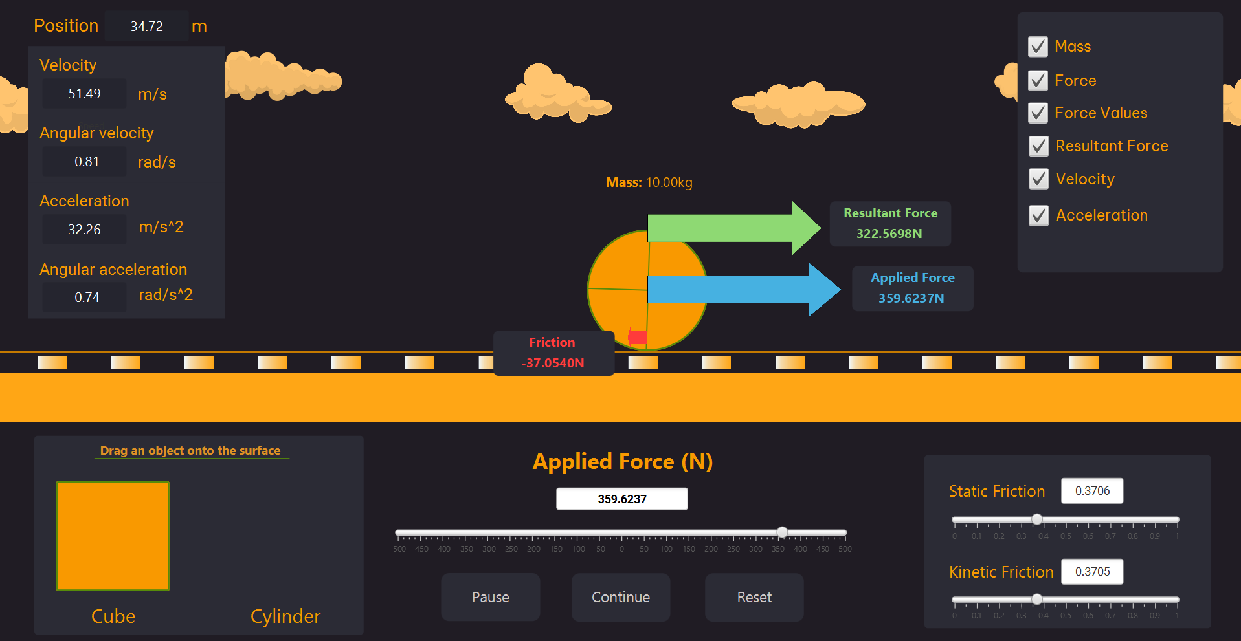
Display motion state
Display forces and mass
Show/hide details
Choose Object
Adjust force
Control Simulation
Adjust friction coefficient

Slide 6
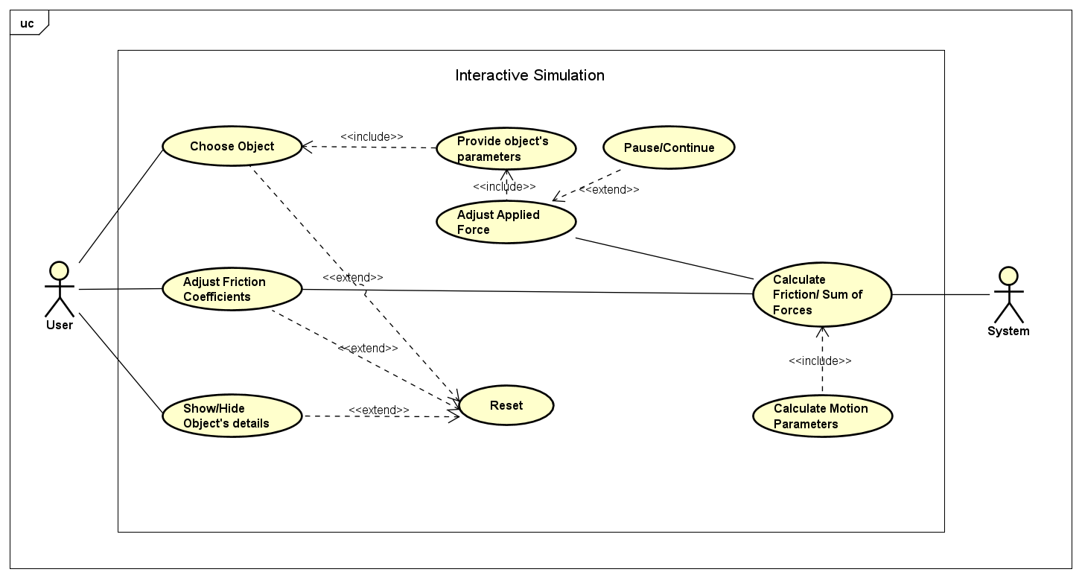
Use Case diagram

Slide 7
2
Class Diagrams

Slide 8
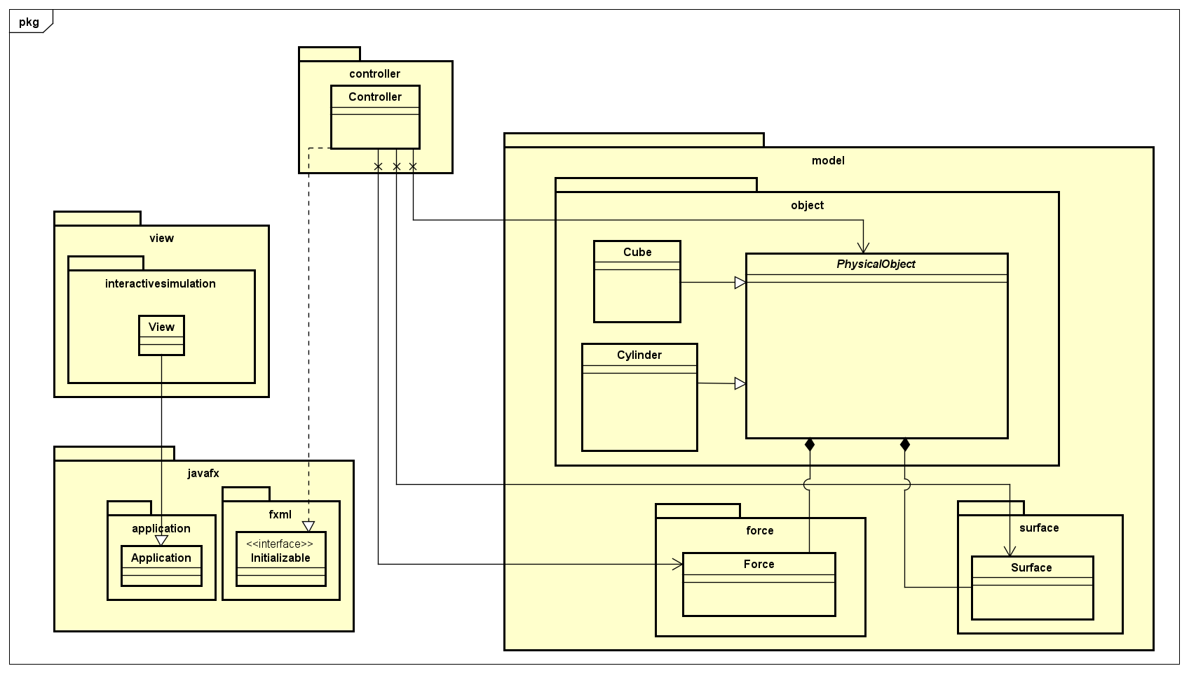
General Class diagram

Slide 9
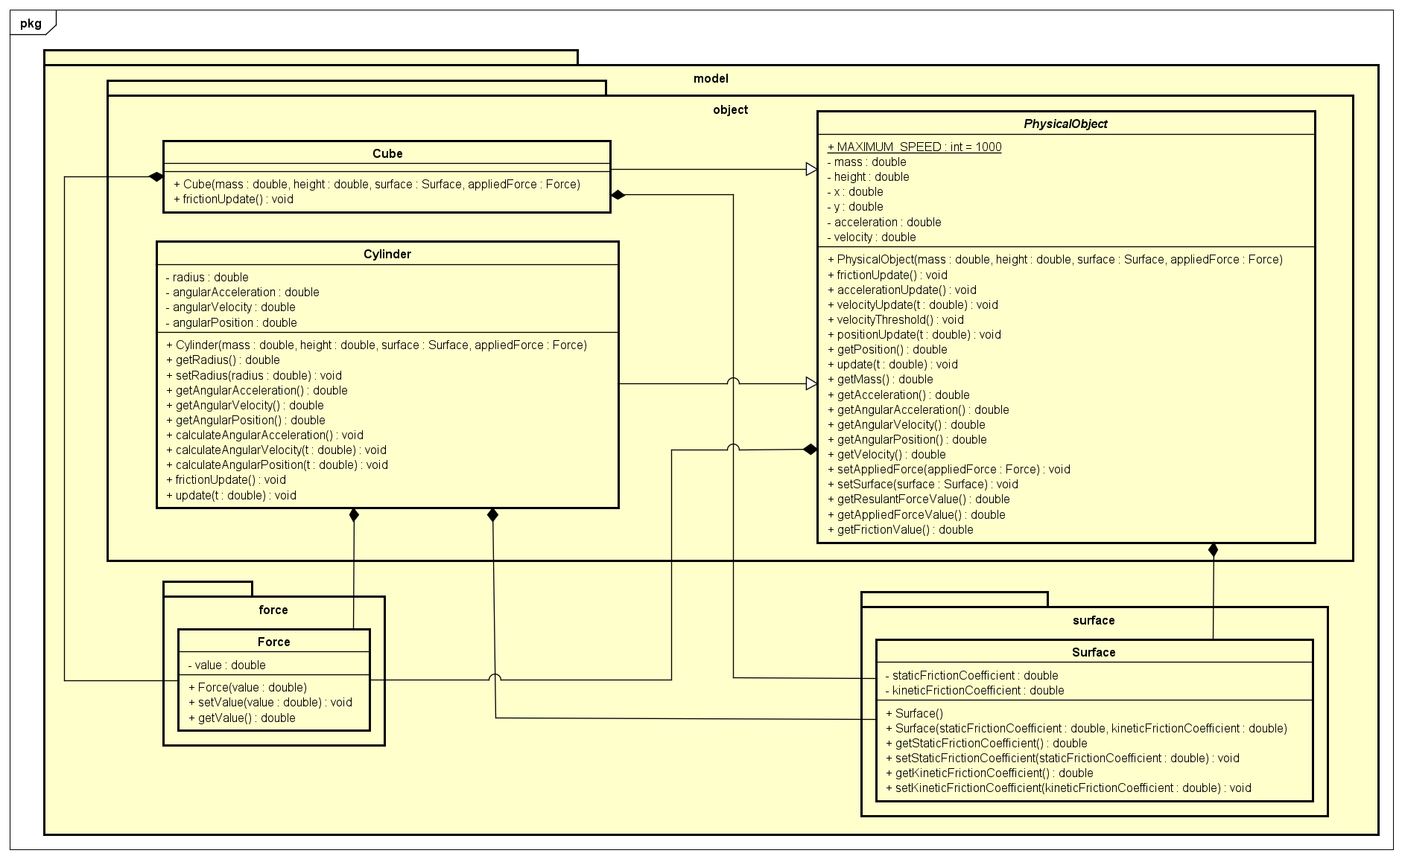
Model package
Association
Composition
Generalization

Slide 10
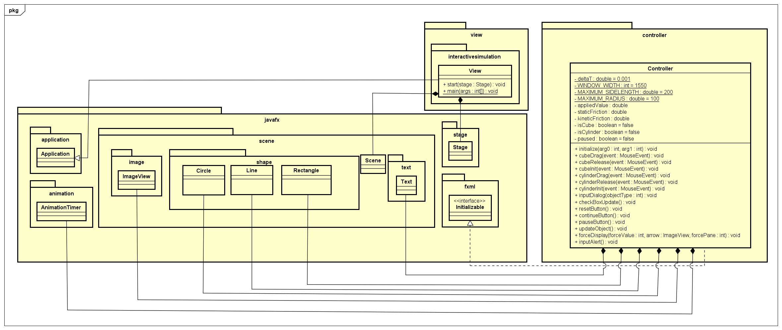
GUI
Association
Composition

Slide 11
3
OOP Technique

Slide 12
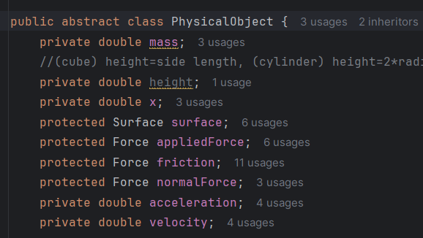
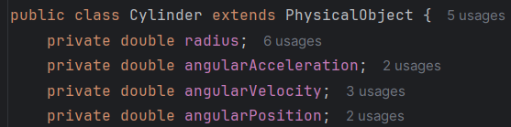
Cube
Cylinder
Inheritance

Slide 13
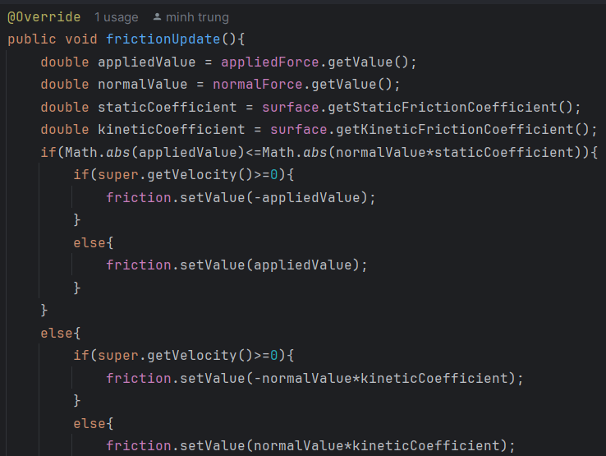
Polymorphism
Cube

Slide 14
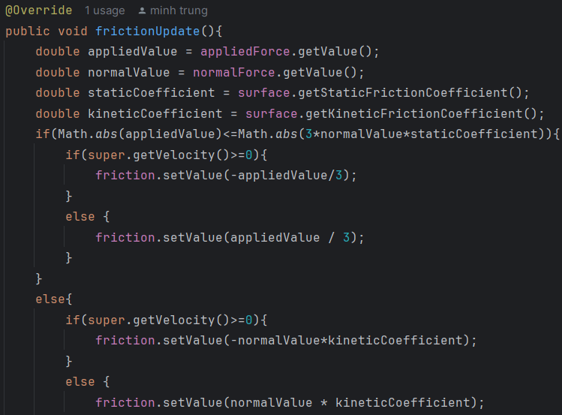
Cylinder

Slide 15
Project
Demonstration
Click here

Slide 16
Thank you
for listening

